Slide 1

AWS Module 3 - vpc

Slide 2
AWS VPC Introduction
Amazon Virtual Private Cloud (Amazon VPC) enables you to launch Amazon Web Services (AWS) resources into a virtual network that you've defined. This virtual network closely resembles a traditional network that you'd operate in your own data center, with the benefits of using the scalable infrastructure of AWS.
Amazon VPC is the networking layer for Amazon EC2.
A virtual private cloud (VPC) is a virtual network dedicated to your AWS account. It is logically isolated from other virtual networks in the AWS cloud. You can launch your AWS resources, such as Amazon EC2 instances, into your VPC.

Slide 3
Private IP Address Range
• 192.168.0.0 - 192.168.255.255 (65,536 IP addresses)
• 172.16.0.0 - 172.31.255.255 (1,048,576 IP addresses)
• 10.0.0.0 - 10.255.255.255 (16,777,216 IP addresses)

Slide 4
VPC and Subnets
A subnet is a range of IP addresses in your VPC. You can launch AWS resources into a subnet that you select. Use a public subnet for resources that must be connected to the Internet, and a private subnet for resources that won't be connected to the Internet.
VPC Address range can be as large as /16 and as small as /28
Subnets can be classified as Public, Private or VPN only

Slide 5
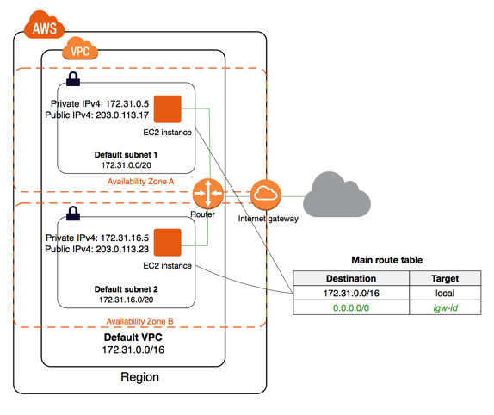
Accessing the Internet in VPC
Your default VPC includes an Internet gateway, and each default subnet is a public subnet. Each instance that you launch into a default subnet has a private IPv4 address and a public IPv4 address.
These instances can communicate with the Internet through the Internet gateway. An Internet gateway enables your instances to connect to the Internet through the Amazon EC2 network edge.

Slide 6
Route table
Your VPC has an implicit router.
Your VPC automatically comes with a main route table that you can modify.
You can create additional custom route tables for your VPC.
Each subnet must be associated with a route table, which controls the routing for the subnet. If you don't explicitly associate a subnet with a particular route table, the subnet is implicitly associated with the main route table.
You cannot delete the main route table, but you can replace the main route table with a custom table that you've created (so that this table is the default table each new subnet is associated with).
Each route in a table specifies a destination CIDR and a target (for example, traffic destined for the external corporate network 172.16.0.0/12 is targeted for the virtual private gateway). We use the most specific route that matches the traffic to determine how to route the traffic.
CIDR blocks for IPv4 and IPv6 are treated separately. For example, a route with a destination CIDR of 0.0.0.0/0 (all IPv4 addresses) does not automatically include all IPv6 addresses. You must create a route with a destination CIDR of ::/0 for all IPv6 addresses
Every route table contains a local route for communication within the VPC over IPv4. If you've associated an IPv6 CIDR block with your VPC, every route table also contains a local route for communication within the VPC over IPv6. You cannot modify or delete these routes.
• When you add an Internet gateway, an egress-only Internet gateway, a virtual private gateway, a NAT device, a peering connection, or a VPC endpoint in your VPC, you must update the route table for any subnet that uses these gateways or connections.
• There is a limit on the number of route tables you can create per VPC, and the number of routes you can add per route table.

Slide 7
Key Point for route table
Main Route Tables
When you create a VPC, it automatically has a main route table. On the Route Tables page in the Amazon VPC console, you can view the main route table for a VPC by looking for Yes in the Main column. The main route table controls the routing for all subnets that are not explicitly associated with any other route table. You can add, remove, and modify routes in the main route table.
You can explicitly associate a subnet with the main route table, even if it's already implicitly associated. You might do that if you change which table is the main route table, which changes the default for additional new subnets, or any subnets that are not explicitly associated with any other route table.

Slide 8
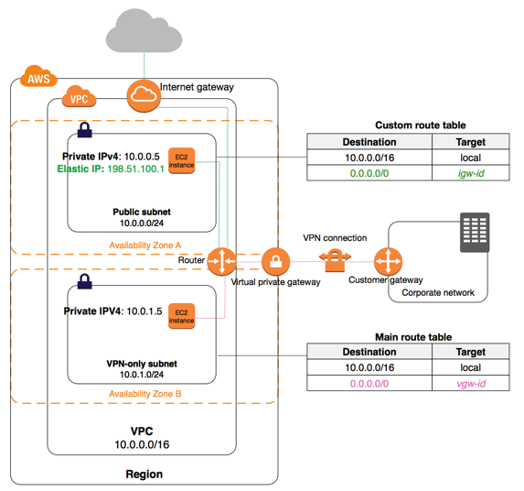
Main Route Table and Custom route table

Slide 9
Internet gateways
An Internet gateway is a horizontally scaled, redundant, and highly available VPC component that allows communication between instances in your VPC and the Internet. It therefore imposes no availability risks or bandwidth constraints on your network traffic
An Internet gateway serves two purposes: to provide a target in your VPC route tables for Internet-routable traffic, and to perform network address translation (NAT) for instances that have been assigned public IPv4 addresses.

Slide 10
vpc nat - network address translation
You can use a NAT device to enable instances in a private subnet to connect to the Internet (for example, for software updates) or other AWS services, but prevent the Internet from initiating connections with the instances
A NAT device forwards traffic from the instances in the private subnet to the Internet or other AWS services, and then sends the response back to the instances. When traffic goes to the Internet, the source IPv4 address is replaced with the NAT device’s address and similarly, when the response traffic goes to those instances, the NAT device translates the address back to those instances’ private IPv4 addresses
AWS offers two kinds of NAT devices—a NAT gateway or a NAT instance. We recommend NAT gateways, as they provide better availability and bandwidth over NAT instances. The NAT Gateway service is also a managed service that does not require your administration efforts. A NAT instance is launched from a NAT AMI.

Slide 11
nat instance
The main route table is associated with the private subnet and sends the traffic from the instances in the private subnet to the NAT instance in the public subnet
The NAT instance sends the traffic to the Internet gateway for the VPC. The traffic is attributed to the Elastic IP address of the NAT instance. The NAT instance specifies a high port number for the response; if a response comes back, the NAT instance sends it to an instance in the private subnet based on the port number for the response.
Amazon provides Amazon Linux AMIs that are configured to run as NAT instances. These AMIs include the string amzn-ami-vpc-nat in their names, so you can search for them in the Amazon EC2 console.
http://docs.aws.amazon.com/AmazonVPC/latest/UserGuide/vpc-nat-comparison.html -difference between gateway and Instance

Slide 12
AWs Connectivity to On Prem Data Centre

Slide 13
AWS - Direct Connect
Dedicated Network path with assured bandwidth
More secure than Internet based IP-Sec VPN
Central Network Control Point
VPG - Virtual Private Gateway, AWS side of VPN connection
CG- Customer Gateway, Customer side VPN connection

Slide 14
AWs VPN Connectivity
VPN connectivity option | Description
AWS hardware VPN | You can create an IPsec, hardware VPN connection between your VPC and your remote network. On the AWS side of the VPN connection, a virtual private gatewayprovides two VPN endpoints for automatic failover. You configure your customer gateway, which is the physical device or software application on the remote side of the VPN connection. For more information, see Adding a Hardware Virtual Private Gateway to Your VPC, and the Amazon VPC Network Administrator Guide.
AWS Direct Connect | AWS Direct Connect provides a dedicated private connection from a remote network to your VPC. You can combine this connection with an AWS hardware VPN connection to create an IPsec-encrypted connection. For more information, see What is AWS Direct Connect? in the AWS Direct Connect User Guide.
AWS VPN CloudHub | If you have more than one remote network (for example, multiple branch offices), you can create multiple AWS hardware VPN connections via your VPC to enable communication between these networks.
Software VPN | You can create a VPN connection to your remote network by using an Amazon EC2 instance in your VPC that's running a software VPN appliance. AWS does not provide or maintain software VPN appliances; however, you can choose from a range of products provided by partners and open source communities. Find software VPN appliances on the AWS Marketplace.

Slide 15

AWS - VPC Peering
A VPC peering connection is a networking connection between two VPCs that enables you to route traffic between them using private IPv4 addresses or IPv6 addresses.
Instances in either VPC can communicate with each other as if they are within the same network.
You can create a VPC peering connection between your own VPCs, or with a VPC in another AWS account. In both cases, the VPCs must be in the same region.

Slide 16
VPC peering limitations
You cannot create a VPC peering connection between VPCs that have matching or overlapping IPv4 or IPv6 CIDR blocks.
You cannot create a VPC peering connection between VPCs in different regions.
VPC peering does not support transitive peering relationships; in a VPC peering connection, your VPC does not have access to any other VPCs that the peer VPC may be peered with. This includes VPC peering connections that are established entirely within your own AWS account.
You cannot have more than one VPC peering connection between the same two VPCs at the same time.
A placement group can span peered VPCs; however, you do not get full-bisection bandwidth between instances in peered VPCs.

Slide 17
Best practice for Vpc design

Slide 18
VPC - LAB
VPC - LAB

